Slide 1
Dynamic Occupancy Models
动态占用模型
AKA:
Multi-season Occupancy,
Robust Design Occupancy
又名
多季节占用模型、
稳健设计占用模型

Slide 2
Single-season – model assumptions
单季节—模型假设
  Sites are closed to changes in occupancy state between sampling occasions
  Species are not falsely detected.
  The detection process is independent at each site
    Far enough apart to be biologically independent.
  No heterogeneity in occupancy
    than cannot be explained by covariates
  No heterogeneity in detection
    that cannot be explained by covariates
  样点在两次采样之间的占用状态变化是封闭的
  物种不会被错误地检测到。
  每个样点的检测过程都是独立的
    样点相距足够远，以保持生物学上的独立性。
  占用状态没有异质性
    没有无法通过协变量解释的差异
  检测无异质性
    没有无法通过协变量解释的差异

Slide 3
Basic sampling protocol same
基本的采样流程相同
Visit sites and spend time looking for individuals of interest or evidence that they are present
到样点考察，并花时间寻找研究相关的个体或表明它们存在的证据
Repeated presence-absence surveys
  Temporal replication at same site
  Spatial replication
  重复的“存在—缺席”调查
  同一地点的时间复制
  空间复制

Slide 4
Important considerations
重要考虑因素
Study design
  Scope of inference
  Elements of stratification and randomization
Strength of inference!
  Strongest – experimental manipulation
  Weaker – constrained designs (e.g., before & after)
  Weaker still – a prior modeling
  Worst – a posteriori storytelling
  研究设计
  推断范围
  分层和随机化的要素
  推断的强度！
  最强—实验操作
  较弱—受限制的设计（如前后对比）
  更弱—先验建模
  最差—事后故事叙述

Slide 5
Patch Occupancy Dynamics:
Pollock’s Robust Design
地块占用动态：
波洛克的稳健设计
Hierarchical sampling scheme:
  Primary sampling periods (seasons) : long intervals between periods such that occupancy status can change
  Secondary sampling periods: short intervals between periods such that occupancy status is expected not to change
分层采样方案
  主要采样期（季节）：采样期之间间隔较长，因此占用状态可能发生变化
  次要采样期：采样期之间的间隔时间较短，预计占用状态不会发生变化

Slide 6
Robust Design Capture History
稳健的设计捕捉历史
Still 2^{n} possible capture histories
History : 10 00 11 01
10 01 11 = presence in primary period 1, 3, & 4
00 =
  Patch occupied but occupancy not detected, or
  Patch not occupied (=locally extinct) yet re-colonized later
仍有 2^{n} 种可能的捕获历史
历史：10 00 11 01
10 01 11 = 表示在主要时段1、3和4存在
00 =
  表示虽然该地块被占用了，但未被检测到（即占用状态未被观察到），或
  也可以表示该地块一开始未被占用（=局部灭绝），但后来又重新被定居

Slide 7
Occupancy dynamics
占用动态
(1−γ) – not colonized
(1−γ) – 未被重新定居
ε – local extinction
γ – colonization
(1−ε) – not extinct
1 - occupied
1-已占用
1 - occupied
1-已占用
1 - occupied
1-已占用
Occupancy
state占用状态
0 - unoccupied
0-未占用
0 - unoccupied
0-未占用
0 - unoccupied
0-未占用
season
季节
Notes:
Changes in population size through time are a function of births, deaths, immigration, and emigration.
The open population CMR models we have considered until now have only estimated apparent survival rates.
That is, true survival, the portion of individuals surviving between sampling occasions is confounded with permanent emigration.
I spoke briefly on closed models that assume that size of the population remained unchanged between sampling events.
Robust design integrates the advantages of both types of models.
Although this model is complicated, it brings more biological reality to the analysis of population dynamics.
This method provides for the estimation of parameters that are not estimable under either open or closed models as well as more robust estimates of the familiar parameters of interest.

Slide 8
Occupancy dynamics
占用动态
– dynamics (γ/ε)
>1.0 – expansion扩展
< 1.0 contraction收缩
1 - occupied
1 - occupied
1 - occupied
Occupancy
state占用状态
0 - unoccupied
0 - unoccupied
0 - unoccupied
season
Notes:
Changes in population size through time are a function of births, deaths, immigration, and emigration.
The open population CMR models we have considered until now have only estimated apparent survival rates.
That is, true survival, the portion of individuals surviving between sampling occasions is confounded with permanent emigration.
I spoke briefly on closed models that assume that size of the population remained unchanged between sampling events.
Robust design integrates the advantages of both types of models.
Although this model is complicated, it brings more biological reality to the analysis of population dynamics.
This method provides for the estimation of parameters that are not estimable under either open or closed models as well as more robust estimates of the familiar parameters of interest.

Slide 9
Inferring population dynamics!
推断种群动态！
Evaluate probability of extinction and colonization
评估灭绝和重新定居的概率
– dynamics (γ/ε)
>1.0 – population expansion (increase)
<1.0 – population contraction (decrease)
λ-动态 (g/e)：
>1.0—种群扩张（增加）
<1.0—种群收缩（减少）

Slide 10
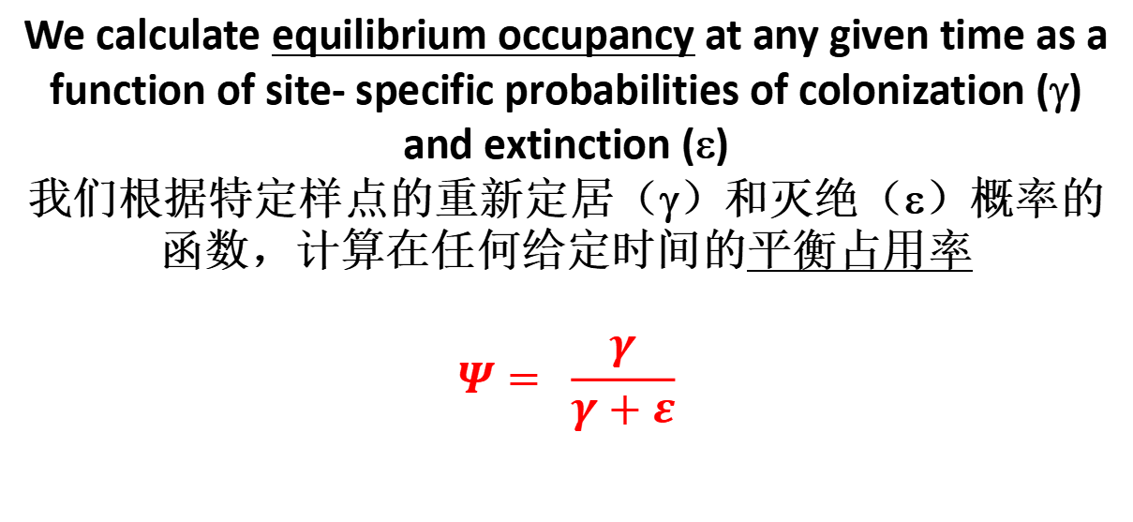
Inferring population dynamics!
推断种群动态！
Evaluate probability of extinction and colonization
评估灭绝和重新定居的概率
We calculate equilibrium occupancy at any given time as a function of site- specific probabilities of colonization (γ) and extinction (ε)
我们根据特定样点的重新定居（γ）和灭绝（ε）概率的函数，计算在任何给定时间的平衡占用率
$$Ψ= \frac{γ}{γ+ε}$$

Slide 11
Basic design
基本设计
Sample over two temporal scales.
Only disadvantage - cost
  more than one sampling occasion each session.
  在两个时间段内进行采样。
  唯一的缺点—成本较高
  因为每段时间内都有不止一次的采样。

Slide 12
Multiple seasons - main assumptions
多季节—主要假设
  Species are not falsely detected.
  The detection process is independent at each site
  No unmodeled heterogeneity in occupancy
  No unmodeled heterogeneity in detection
  Closure:
    No colonization and extinction between secondary periods
    No unmodeled heterogeneity in colonization or extinction between primary periods
  物种不会被错误地检测到
  每个样点的检测过程都是独立的
  占用状态没有未建模的异质性
  检测没有未建模的异质性
  封闭性：
    次要时段之间没有重新定居和灭绝
    主要时段之间没有未建模的重新定居或灭绝的异质性

Slide 13
Patch Occupancy as a State Variable:
Modeling Dynamics
作为状态变量的地块占用：建模动态
Model changes in occupancy over time
Parameters of interest:
  ψ – probability of occupancy
  ε_{t} – Pr(absence at time t+1 | presence at t) patch extinction probability
  γ_{t} – Pr(presence at t+1 | absence at t)
  patch colonization probability
  p_{i} – Pr(detection on occasion i) detection probability
  占用状态随时间变化的模型
相关参数：
  ψ - 占用概率
  ε_{t} - Pr(在时间 t+1 时缺席 | 在时间 t 时存在) 地块灭绝概率
  γ_{t} – Pr(在时间 t+1 时存在 | 在时间 t 时缺席) 地块重新定居概率
  p_{i} - Pr(在第 i 次采样时检测到) 检测概率

Slide 14
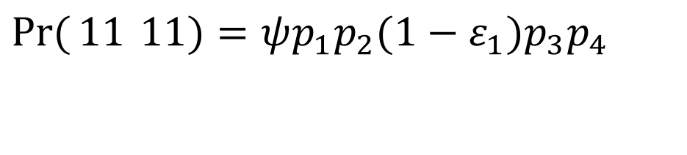
Probability models
概率模型
Must account for probabilities of colonization & extinction
必须考虑定居和灭绝的概率
Examples例如:
$$\operatorname{Pr}{(}11 11)=ψp_{1}p_{2}(1−ε_{1})p_{3}p_{4}$$

Slide 15
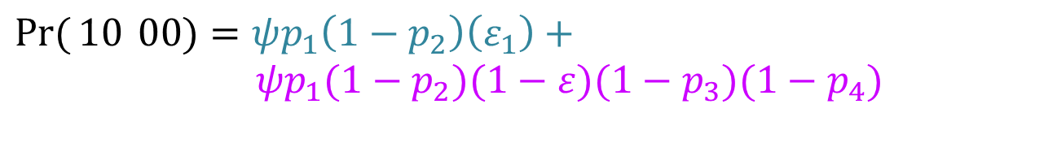
Probability models
概率模型
More examples更多例子:
$$\operatorname{Pr}{(}10 00)=ψp_{1}\left(1−p_{2}\right)\left(ε_{1}\right)+$$
$$ψp_{1}(1−p_{2})(1−ε)(1−p_{3})(1−p_{4})$$
Occupied and detected on first, not detected on second and then unoccupied (extinct)
OR
Occupied and detected on first, not detected on second and remained occupied but undetected on third and fourth.
在第一个时段内被占用且被检测到，第二个时段未被检测到，然后变为未被占用（灭绝）。
或者
在第一个时段内被占用且被检测到，第二个时段未被检测到，但在第三和第四个时段仍然被占用，只是未被检测到。

Slide 16
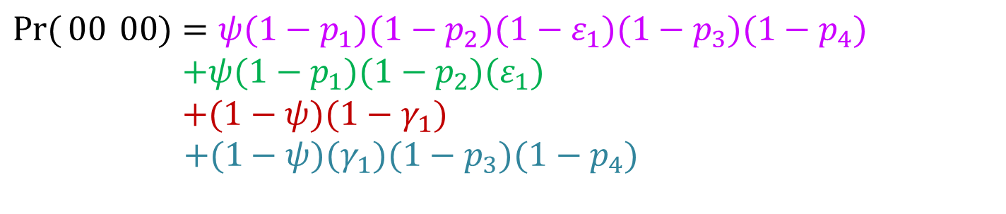
Probability models
概率模型
$$\operatorname{Pr}{(}00 00)=ψ(1−p_{1})(1−p_{2})(1−ε_{1})(1−p_{3})(1−p_{4}) \\ +ψ(1−p_{1})(1−p_{2})(ε_{1}) \\ +(1−ψ)(1−γ_{1}) \\ +(1−ψ)(γ_{1})(1−p_{3})(1−p_{4})$$
Occupied and not detected on first and second, not extinct and not detected on second and fourth
OR
Occupied and not detected on first and second and then unoccupied
OR
Not occupied and not colonized
OR
Not occupied and colonized and undetected on third and fourth.
被占用但在第一和第二次采样中未被检测到，且在第二和第四次采样中未灭绝。
被占用但在第一和第二次采样中未被检测到，然后在第三和第四次采样中变为空缺。
未被占用且未被重新定居。
未被占用但被重新定居，且在第三和第四次采样中未被检测到。

Slide 17
Conclusions
结论
“Presence-absence” surveys can be used for inference when repeat visits permit estimation of detection probability
Models permit estimation of occupancy during a single season or year
Models permit estimation of patch-dynamic rate parameters (extinction, colonization, rate of change) over multiple seasons or years
当我们进行“存在—缺席”调查时，如果能够多次重复考察同一样地，从而估计出物种被检测到的概率，那么我们可以利用这些信息来推断物种的占用状态。可以估计物种在不同时间点上是否存在于该样地。
这些模型可以在单个季节或年度内对占用率进行估计。
这些模型可以在多个季节或年度内对某些地块的动态率参数（灭绝、重新定居、变化率）进行估计。

